Slide 1

DIGITAL THERMOMETER
22AIE115- User Interface Design
22AIE114 Introduction to Electrical and Electronics Engineering
K. INIYA - CB.SC.U4AIE24118
M.V.MUKESH - CB.SC.U4AIE24138
P. VARSHITHA - CB.SC.U4AIE24144
U.V. KRISHNA SUDEEPTHI - CB.SC.U4AIE24165

Slide 2
Introduction
Definition : A digital thermometer is an electronic device that measures temperature accurately and quickly.
Working : Uses sensors to detect temperature and displays readings on a digital screen.
Advantages : Fast, accurate, safe, and easy to use.
Applications : Healthcare, laboratories, industrial settings, and environmental monitoring.
Features : Battery-operated, automatic shut-off, memory function, and backlit display (in some models).

Slide 3
Methodology
Detection :Uses a thermistor or infrared sensor to detect body or ambient temperature. The sensor's resistance changes with temperature variations.
Signal Processing :Converts the temperature-dependent resistance into an electrical signal. The microcontroller processes the signal and applies calibration algorithms for accuracy.
Display Output :The processed temperature value is displayed on an LCD or LED screen.
User Interaction :The user places the thermometer in the required position (oral, ear, forehead, etc.).After a few seconds, the temperature is displayed, often with a beep indicating measurement completion.
Regular checks ensure long-term reliability.

Slide 4
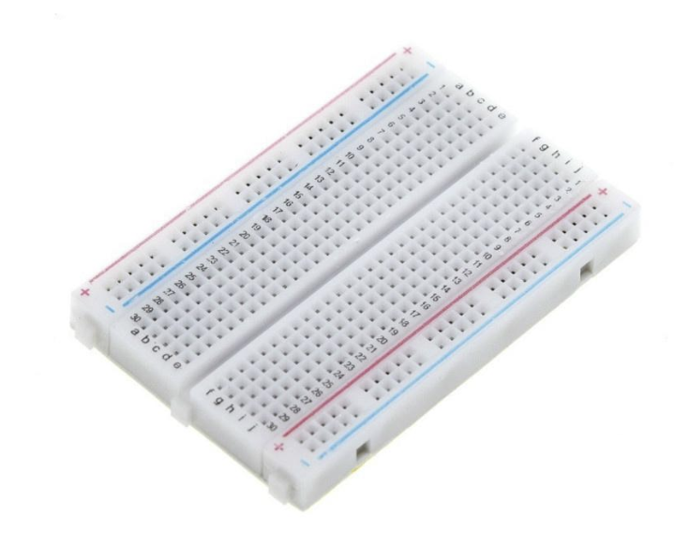
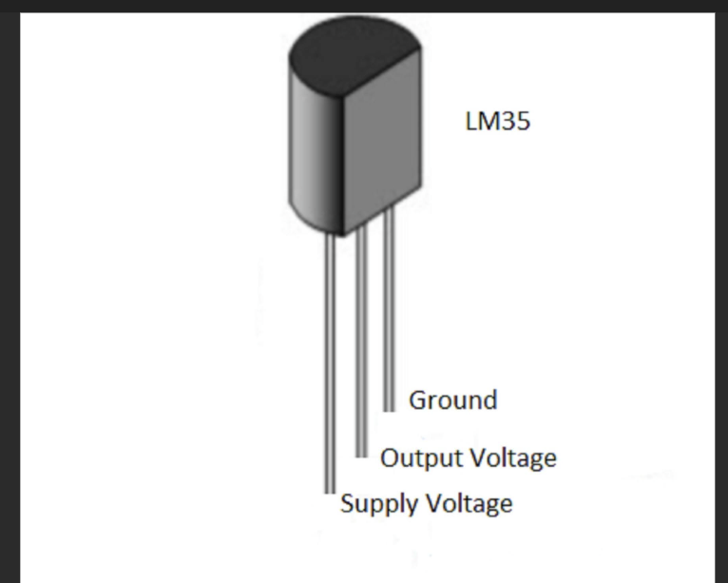
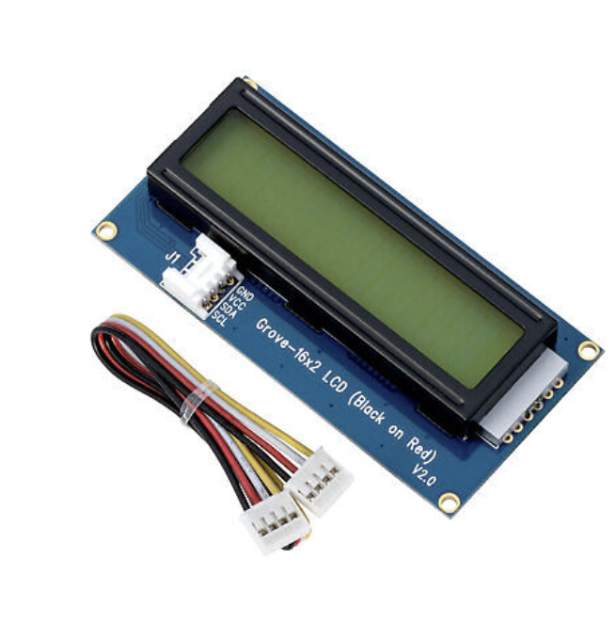
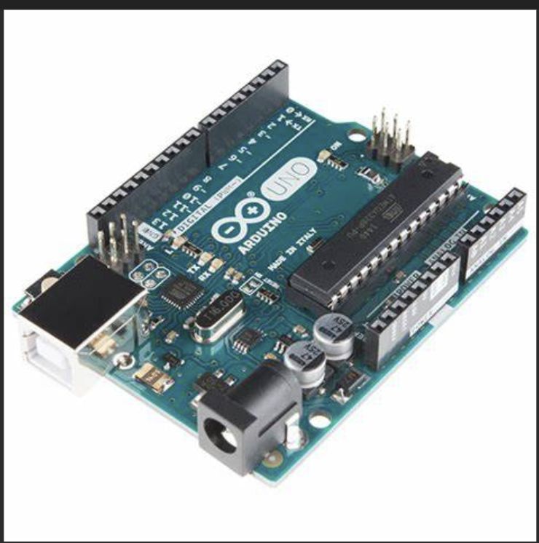

Components
LCD display
Potentiometer
LM35
Arduino Uno
Breadboard
Battery and connecting wires

Slide 5
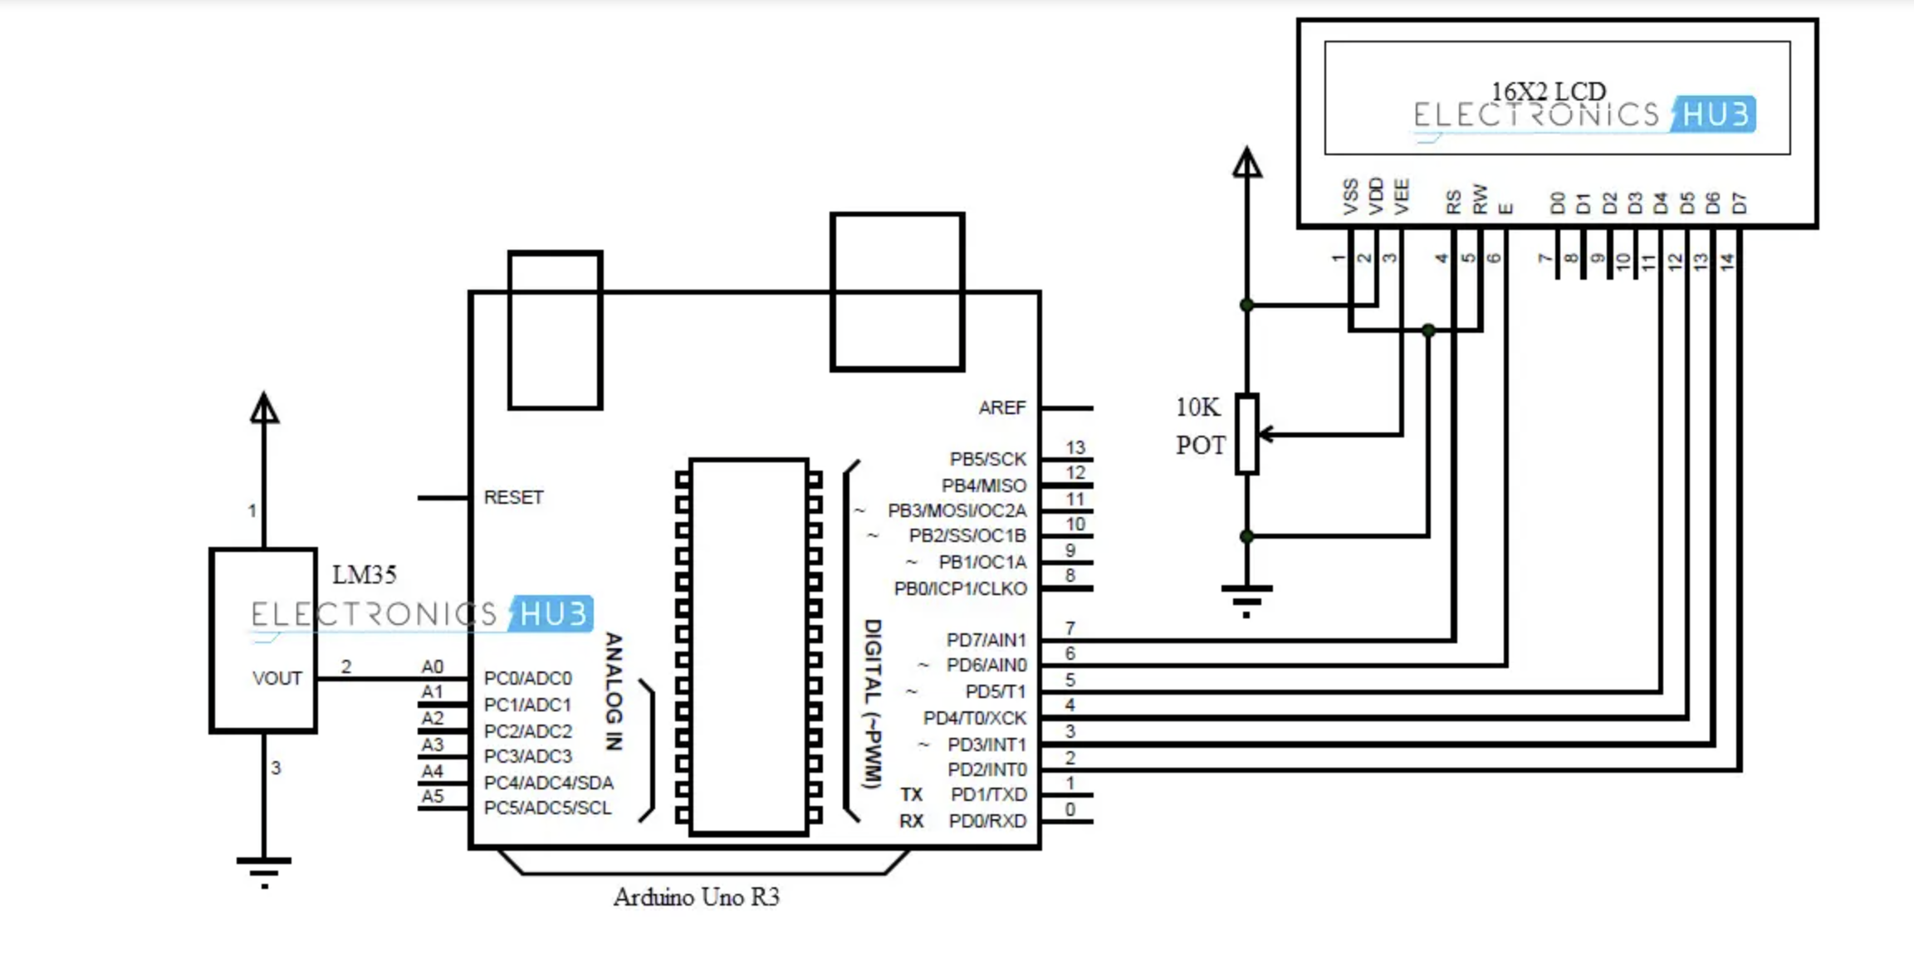
Circuit Diagram

Slide 6
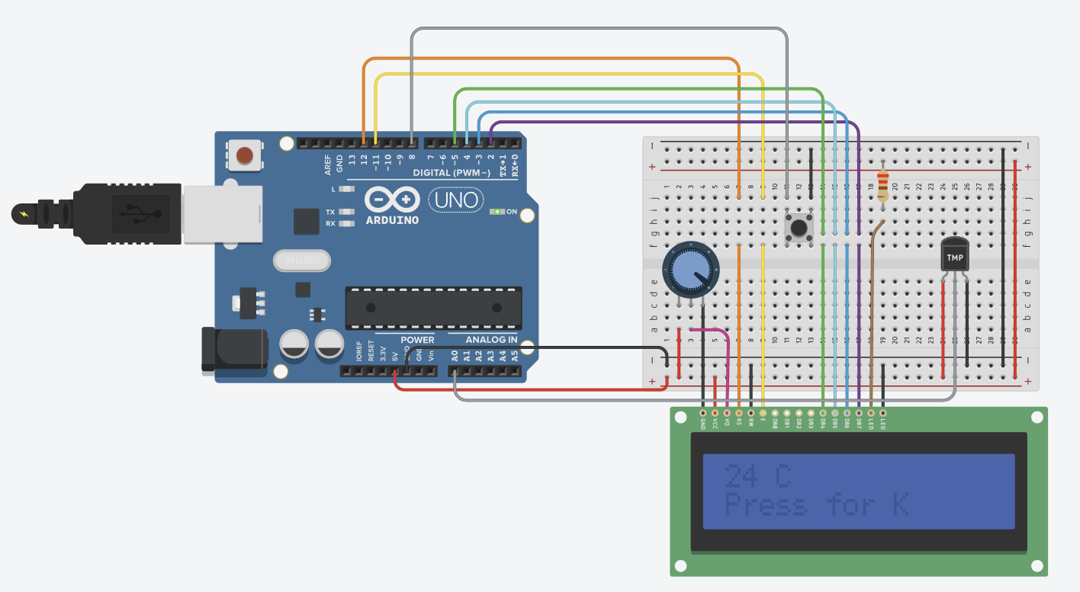
Tinkercad Sample

Slide 7
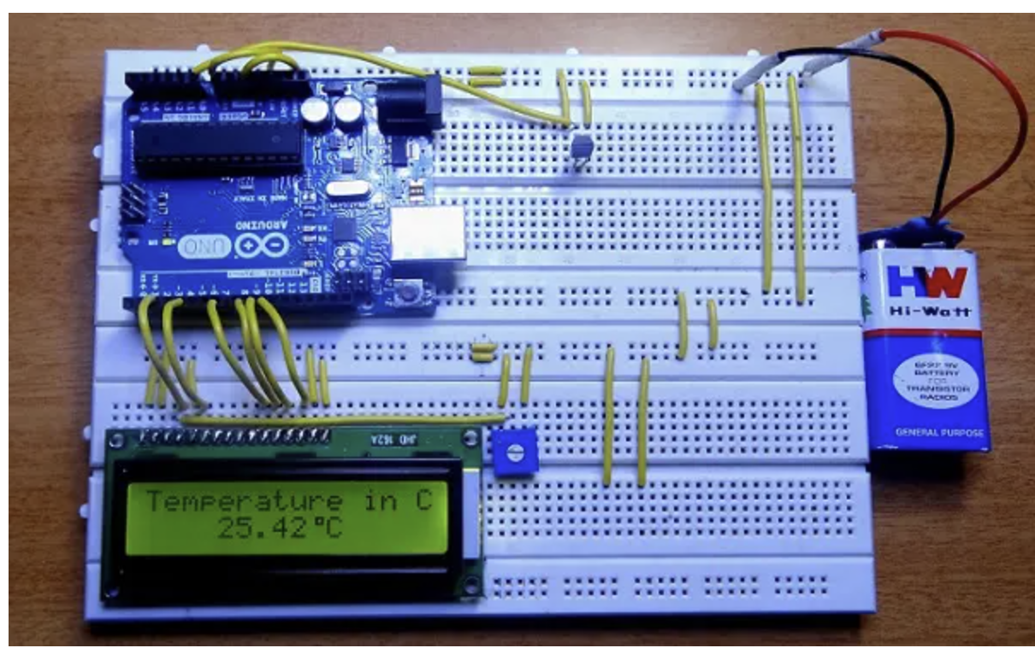
Expected Output

Slide 8
THANKYOU

